Slide 1

Codenizant
Compliance Guide
- Process and Templates
20110410

Slide 2
Codenizant & Omega Overview

Slide 3
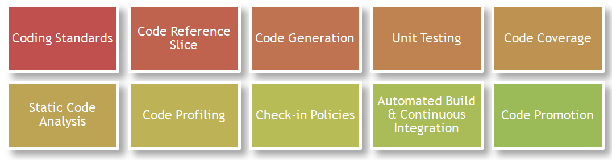
Core Engineering Practices (CEP10)
URL: https://gto.cognizant.com/codenizant/SitePages/Home.aspx

Slide 4
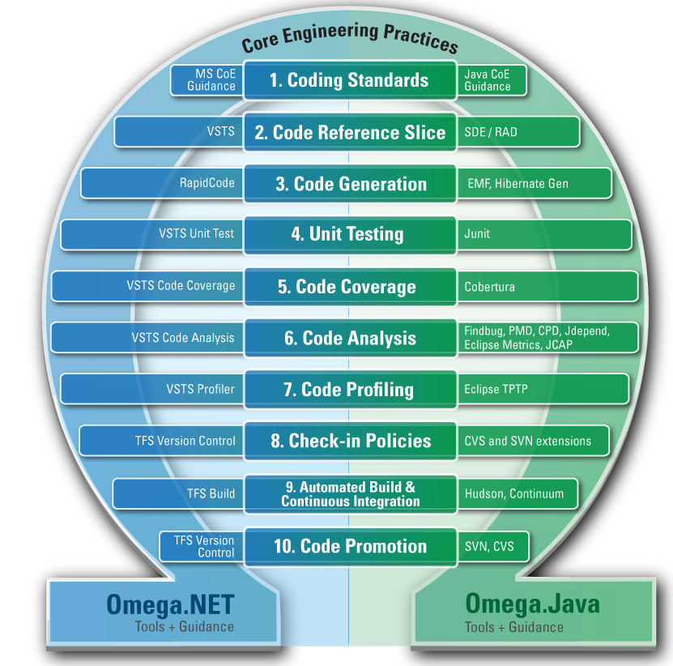
Omega Platform
URL: https://gto.cognizant.com/codenizant/SitePages/Omega.aspx

Slide 5
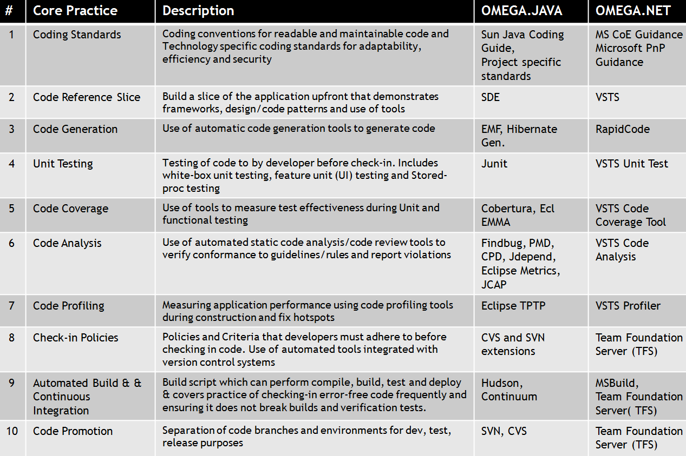
Omega Toolsets

Slide 6
Codenizant Process
- Adoption & Compliance

Slide 7
[1] Enable
URL: https://gto.cognizant.com/codenizant/SitePages/enable.aspx
Frequent Omega.java and Omega.NET training sessions through Academy.
2-3 ILT Sessions every month - Schedule details published in Academy calendar.

Slide 8
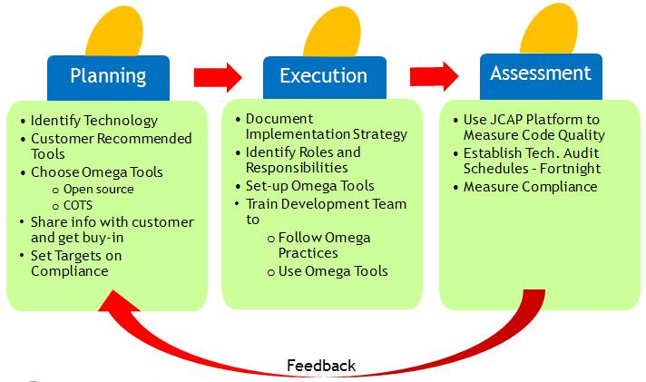
[2] Engage
URL: https://gto.cognizant.com/codenizant/SitePages/Engage.aspx

Slide 9
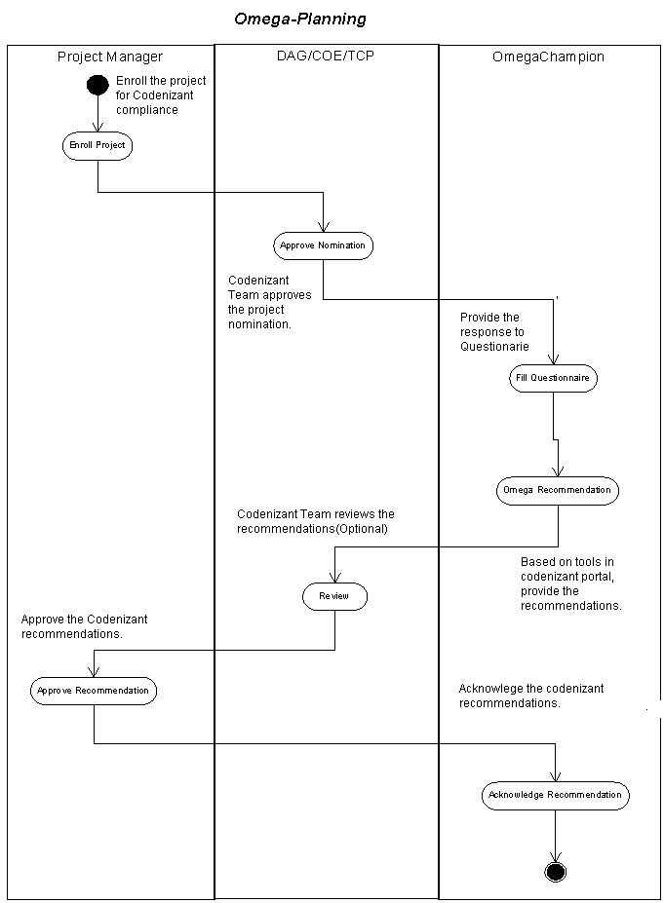
[2.1] Engage -> Planning
URL: https://gto.cognizant.com/codenizant/SitePages/ProcessFlowChart.aspx

Slide 10
[2.2] Engage -> Execution
Enroll your projects.
Mandated for all AD projects, started in 2011, and included in PHS.
Enroll at: https://gto.cognizant.com/codenizant/Lists/OmegaRegistration/NewEnrollment.aspx
Fill Questionnaire (Checklist)
Review readiness and plan scope through Start-Up checklist.
Track compliance through Periodic checklist.
Assess current state and plan improvements.

Slide 11
[2.3] Engage -> Assessment
Evaluate Adoption (Score card)
Use score card to evaluate the level of compliance (and score).

Slide 12
[3] Govern
Audit by DAG with help from CoE /Vertical TCG.
Start up Audits (Understand scope for Omega setup)
Delivery Audits (Measure effectiveness of using Omega)
Omega score computed based on the score card in previous slide.
Omega score and trend reports will be published monthly.
Score Computation is
Automated (partly) through Code Assessment platforms (JCAP and NCAP for Java and .NET respectively).
Manual through Score card for projects not using JCAP/NCAP.

Slide 13
Expectation
Level 1 compliance expected for now.
Good score and Acceptable score (compliance with warning) for level 1 compliance are as mentioned in the Score Card.
Any score below the Acceptable limit will be reported as NC.

Slide 14
End

